Slide 1
Modeling Collaboration
SAA Research Forum, Washington, D.C. , 14 August 2018
The Frank Lloyd Wright Foundation Archives:
A Case Study in Joint Stewardship
Pamela Casey & Shelley Hayreh
Avery Drawings & Archives
Notes:
Pamela
Introduce self, Architecture Archivist at Avery Drawings & Archives
Introduce topic for talk today
Shelley
Introduce self, Avery Archivist. Our department is one of Avery’s 3 special collections, and we focus on collecting architectural records of mainly American architects and firms from the 19th and 20th centuries.
Pamela
Our department head, Jennifer Gray, was not able to be here with us today, but has been a part of this collaboration since the beginning. Jennifer was co-curator of a major Frank Lloyd Wright show at MoMA in 2017, and joined Avery as curator of Drawings & Archives in February this year.

Slide 2
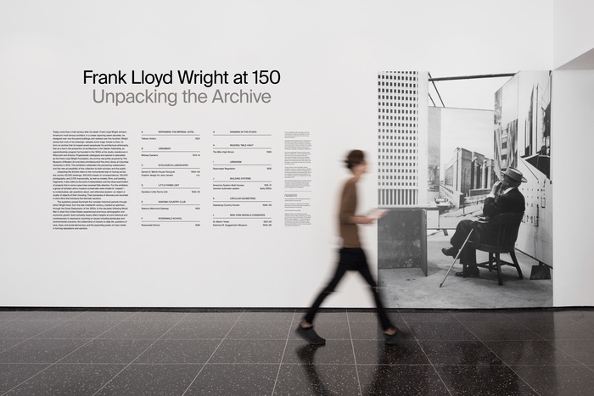
Overview
Partners
Collection Scope
Expectations & Deliverables
Processing Challenges
Outcomes and Takeaways
Installation view of the MoMA exhibition, “Frank Lloyd Wright at 150: Unpacking the Archive” (June to October 2017), photograph by Robert Gerhardt
Notes:
Pamela
In 2012, Avery Library at Columbia University and the Museum of Modern Art co-acquired the Frank Lloyd Wright Foundation Archives.
Today we’ll talk about the joint stewardship of this collection, about the partners and details of this partnership, about the collection and its scope. We’ll cover some of the expectations and deliverables of the joint acquisition agreement, the impact exhibition activities had on processing this collection, and offer some takeaways.

Slide 3
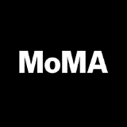
Partners in Joint Stewardship
Avery Architectural & Fine Arts Library, Columbia University
The Museum of Modern Art
The Frank Lloyd Wright Foundation
Notes:
Shelley
The Frank Lloyd Wright Foundation Archives were created and maintained after Wright’s death at Taliesin West in Scottsdale, Arizona. The Foundation has been dedicated to preserving the legacy of Wright’s ideas, architecture and design, and utilized the archive to this end.
From 2011, the Foundation was seeking a new home for the collection. MoMA and Avery put forth a joint proposal to acquire the collection as co-owners, the shared goal being to increase access to researchers and increase exposure through exhibitions for the collection
It’s important to note that each partner institution has very different mandates, audiences, and activities.
Avery Library is a research institution dedicated to access and scholarship, and MoMA is an international museum exhibiting and collecting modern and contemporary art and architecture.

Slide 4
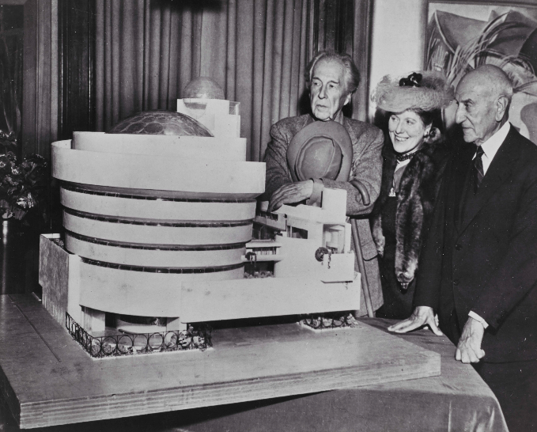
Frank Lloyd Wright Foundation Archives
Avery Drawings & Archives:
3 collection ingests 2013-2016
Total extent ca. 70,000 drawings and ca. 1,700 linear feet of records
Provides all public services to collection
MoMA:
62 models and design prototypes
Limited to no public services
Frank Lloyd Wright, Hilda Rebay, Solomon Guggenheim at the unveiling of the model (1945) (PH#6805.0002)
Notes:
Pamela
With the joint acquisition by Avery and MoMA, the decision was made to split the collection between each institution based on their strengths.
As an active architectural records archive, Avery was the natural home for all paper-based materials such as architectural drawings, correspondence, papers, and photographs, as well as all time-based media such as interview tapes, audio reels and films.
MoMA serves as the repository for all 3D works such as models, architectural elements and design prototypes.
The acquisition was broken down into 3 major transfers:
The 1st was the core historic collection, so everything pre-1959. Approximately 30,000 drawings and 1000 linear feet came to Avery in 2012, and 62 objects went to MoMA.
The 2nd and 3rd transfers to Avery focused mainly on the records and drawings of TAA, the Taliesin Associated Architects. These documented projects that began during Wright’s lifetime and were completed after his death. These 2 transfers meant that an additional 40,000 drawings and 700 linear feet of material were added to Avery’s collection.
It’s important to reiterate that MoMA’s physical share of this vast collection is only 62 items, so Avery is really the primary physical repository for the archive.
In addition, Avery provides all public services to the collection, including research and reference, publication and imaging requests. MoMA conserved the models and objects but provide limited to no research access to these items.

Slide 5
Agreement Expectations and Deliverables:
Processing, Access, Education, Exhibition(s)
Within the first year:
First collection ingest to Avery
Core collection open for research
Columbia Art History class on Frank Lloyd Wright
“Density vs. Dispersal” MoMA exhibition (2014)
Within 5 years:
Two additional ingests
Full intellectual and physical control of the collection
All 15 collections open for research
“Frank Lloyd Wright at 150: Unpacking the Archive” MoMA exhibition
Notes:
Shelley
The partnership agreement laid out a 5 year plan for processing, access, and exhibitions. The first year deliverables included ingesting of the core collection, opening the majority of that collection to researchers, and ending the year with an exhibition at MoMA celebrating the joint acquisition.
Even though Avery came into this partnership already equipped to handle the ingest, processing, and servicing of a large archival collection, this was still the largest collection Drawings & Archives had every acquired. We also need to prepare considerably prior to the collection’s arrival. Preparations included clearing out vault space, coordinating with art movers, surveying and packing the collection at Taliesin West, and creating a working plan for the ingest.
When the collection began arriving to our vaults in late spring 2013, we focused our efforts on unpacking, registering and rehousing the 30,000 architectural drawings. This first priority was informed by three factors: 1) the need for intellectual and physical control over the most high-profile portion of the collection; 2) the fall 2013 deadline to open the archive to researchers and an upcoming Columbia course on Frank Lloyd Wright; and 3) an introductory one-gallery exhibition at MoMA highlighting the acquisition.
Pamela
After the expectations of the first year, the acquisition agreement laid out a further 5 year plan:
That all processing would be completed and the bulk of the archive would be open for research within 5 years
That there would be a major show at MoMA on Frank Lloyd Wright and the archive. This show across 13 galleries totaling 10,000 square feet, opened in June 2017
That there would be an ongoing display of Wright material at MoMA starting in 2019.
At Avery, the EAD finding aids for the bulk of the collection were completed and published in 2017. We have also been working on a collection website to host these finding aids and consolidate other library resources such as research guides. This will launch later this year or early next
Thus, processing and inventorying this archive has always happened simultaneously with other demanding activities such as ongoing exhibition research and preparation, planning for additional collection shipments and ingests, handling reference and researcher requests, managing our busy reading room, class integration and other outreach activities, and the continued acquisition and maintenance of our other non-Wright collections.

Slide 6
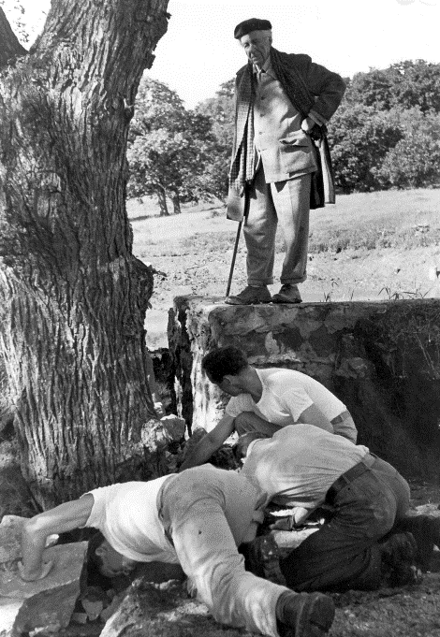
Processing Challenges
Exhibition demands challenge traditional processing approaches
Unprocessed collections open for research
Item level description vs. higher level
Refocused collection priorities due to ongoing exhibition program
Frank Lloyd Wright watching apprentices at work (1949)(PH#6006.0051)
Notes:
Shelley
This joint acquisition has been beneficial and challenging for both partners, but for the sake of brevity today we’re focusing on how exhibition demands influenced processing decisions.
The most challenging aspect of this collaboration has been the effect of exhibition demands on our work in the archive. Additionally, we were a very slim team at Avey, with myself as the only processor of this collecton until Pamela joined in late 2016 .
Typically, archivists would have time to survey the entirety of a collection before making major processing choices. In this case, immediate use of the collection– namely research for the mounting of the first MoMA exhibition -- was prioritized. As soon as the core collection arrive, we opened it up for curatorial research, even though we had not had the chance to survey all of it on-site. To faciliate exhibition research on unprocessed collections, we create quick and dirty inventories that to this day are some of our only access tools for certain portions of the collection. Additionally, we found ourselves adopting the legacy inventory numbers from the Foundation in order to faciliate collection management. As a result, we ended up maintaining a legacy system which, if given more time, we might have decided against keeping.
Other challenges that affected processing include items being pulled before they could be described or checked in, the lack of a system for a large research team looking through unprocessed materials, and a massive checklist that pulled from almost every collection in the vast archive.
Pamela
Another major challenge has been around reconciling item level description with our preferred higher level descriptive process
When the archive was created, the Foundation imposed an item level accessioning and descriptive system. Meanwhile, exhibitors like MoMA always work at the item level. Because of legacy practices and pressing exhibition demands, we’ve found ourselves having to take a museum approach to large parts of the collection, despite this not being preferred best practice.
This focus on servicing exhibition needs has also meant that other collection priorities at Avery have been sidelined
For instance, our limited conservation resources within Columbia Libraries have been focused on items going into shows,
And many of our other collections have simply not been getting the attention they normally would because of our focus on Wright

Slide 7
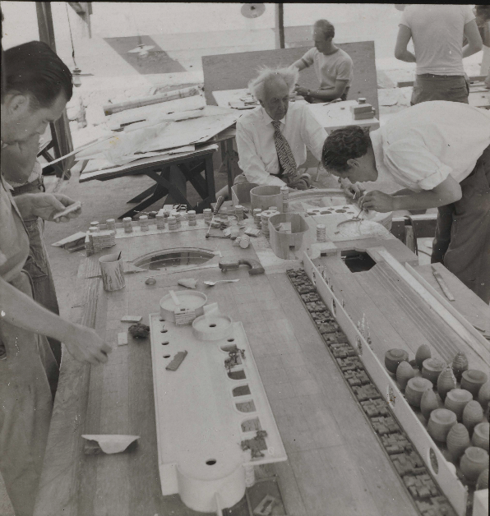
Outcomes
Bigger team
New workflows
More (mainly financial) support
Increased exposure
Classes and tours
Research and publication
Exhibitions driven by Avery
Model building, Frank Lloyd Wright with Taliesin fellows (undated) (PH#3803.nn)
Notes:
Shelley
Overall, the collaboration between Avery and MoMA has been incredibly fruitful. The exposure for the collection is significantly higher than if just one of our institutions was the sole owner. This added exposure, aggressive exhibition agenda and high research demand has lead to more financial resources and Avery having the capacity to grow its team. We hired one more permanent archivist, Pamela, and are in the process of hiring a new Public Services Archivist. Avery also hired a Registrar to manage exhibition and imaging services, and we will soon hire a Digital Content Assistant.
Pamela
More staff has meant we are able to do more. We’ve developed a strong outreach program for the archive and more than doubled our class offerings since the arrival of Wright. We’ve also had an increase in pop up shows for visiting groups, tours and donors
We now have a working infrastructure to service exhibition demands, and despite teething problems, are continually developing workflows and systems to meet these needs
All this activity has definitely made a difference in terms of support within our institution, including increased supply budgets and the ability to refit our vaults.
Having the Wright archive in our holdings and the experience of supporting major exhibitions at MoMA has definitely increased Avery’s profile. In the last two years, Avery has taken the lead on two additional Wright exhibitions: one at Columbia’s Wallach Gallery in 2017 and the other in Turin, Italy in March this year.

Slide 8
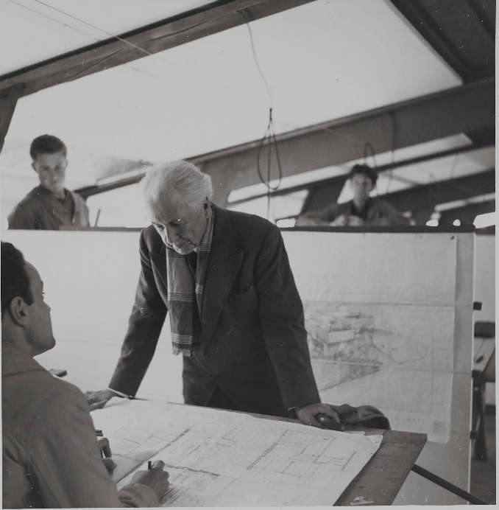
Takeaways
Flexibility is essential to overcome the friction between processing work and exhibition needs
Joint partnership credit lines can be very long…
Have you had similar experiences?
Frank Lloyd Wright in the drafting room at Taliesin West (#6104.0045)
Frank Lloyd Wright Foundation Archives
(The Museum of Modern Art | Avery Architectural and Fine Arts Library, Columbia University)
Notes:
Shelley
One of the biggest takeaways from this collaboration for us has been that archival processing and exhibition planning will inevitably mean very different timelines and expectations, it’s important to be flexible in the reconciling of these two different agendas.
Pamela
And finally, with a joint collection, we all now have to deal with a very long credit line...
We’d love from you if you’ve had similar experiences, especially if you have also had to balance processing needs of a large collection with an active exhibition programme.
Thank you!

